Slide 1
Advanced Machine Learning
Lecture 1

Slide 2
What is Machine Learning?
“The use and development of computer systems that are able to learn and adapt without following explicit instructions, by using algorithms and statistical models to analyze and draw inferences from patterns in data.”
Oxford English Dictionary

Slide 3
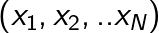
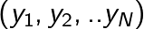
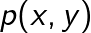
A more technical description
Given a set of training examples potentially with corresponding labels we would like to infer some properties of the population distribution
Name some ML tasks, what is x and y and how the desired output is related to ?

Slide 4
Why is ML Hard?
The data x are often high dimensional
The number of training samples N is limited
We may not have labels y for all data
The probability density can be quite complex
What are some other issues that make ML hard?

Slide 5
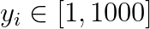
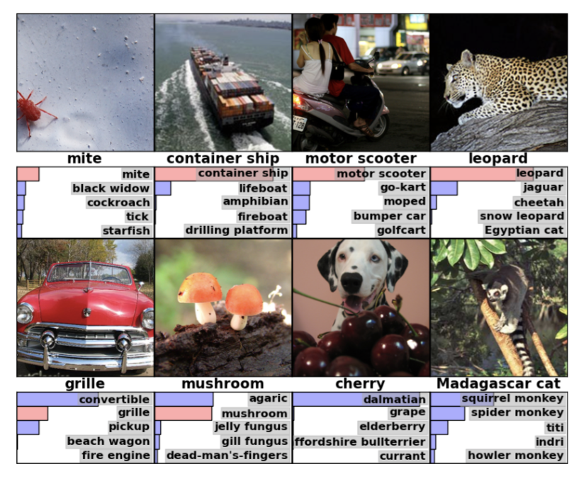
Running example
Let us introduce a running example for this lecture.
ImageNet is a large-scale dataset (maybe, mid-scale these days)
~1 million high-resolution images (x₁,x₂..x_{n}), n=1e6
Images labelled as 1 of 1000 categories (y₁,y₂..y_{n})

Slide 6
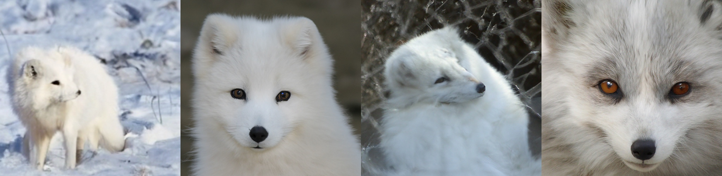
Two important directions
Machine learning tasks are often split into 2 categories:
Discriminative: estimate P(y|x)
Example: object category classication given image
Generative: estimate P(x|y)
Example: generate new images given category label

Slide 7
More exciting than it sounds!
The formal descriptions sound a little dry
We’ll see that it important to have a clear formalism
Many super important (and/or cool) applications
One of the faster moving part of computer science at the moment

Slide 8
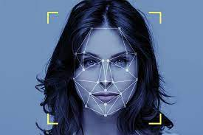
Discriminative examples
Face recognition methods can recognize 1 in 10⁹ people
Task: estimate p(y|x)

Slide 9

Generative Example
DallE-2/Imagen/Stable Diffusion 2 generate images by text guidance
Give examples of the most important applications of discriminative and generative ML methods

Slide 10
Relation between ML to Statistics
ML is at the intersection of computer science and statistics
CS: can we find the solution with high computational efficiently?
Statistics: can we learn with a small number of samples?
See: Machine learning: Trends, perspectives, and prospects, Science 2015
In practice:
ML often does not assume distribution, statistics often does
ML cares less about confidence bounds, core task for statistics
Modern ML methods are often more heuristic

Slide 11
Relation between ML to Optimization
ML: often finding parameters to optimize some loss objective
This is within the scope of optimization – a deep, older discipline
Most optimization theory applicable for convex objectives
Modern ML objectives are not convex

Slide 12
Topics for This Course with Estimated Times
Weeks 1-2: Review of supervised learning and deep NNs
Weeks 3-7: Generative models
Weeks 8-10: Representation learning
Weeks 11-12: Learning with limited supervision
Weeks 13-14: Miscellaneous

Slide 13
Weeks 1-2: Supervised Learning, Deep NNS
Week 1:
Motivation for ML and general problem definition
Course overview and requirements (you are here)
Review of key supervised learning material from IML
Week 2:
Definition of deep learning and basic building blocks
A general framework for modern deep architectures
Applications

Slide 14
Course Details
The lectures will take place on Wednesday 10-13
My reception hour is at Wed at 9 (might change)
You must physically attend 50% of the lectures
Students who attend more lectures, will receive a small bonus
Two compulsary practical exercises (20% of the grade)
Final exam (80% of the grade)

Slide 15
Course Etiqutte
Do come to the lectures
Do ask questions
Do come to speak to me during the break, even just for an intro

Slide 16
Supervised ML
Given:
A set of training examples x₁,x₂..x_{n} sampled IID from distribution P
Corresponding labels y₁,y₂..y_{n}
Objectives: learn a function f, which can predict y for all x in P
Examples: ImageNet classification, face recognition

Slide 17
Fitting to Training Set
Let’s assume our training set is massive, no difference from test
Want to find the function that maps x to y
Assume we specify this function by a set of parameters (weights) W
Need an objective L(W), s.t. lowest value corresponds to best solution

Slide 18
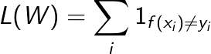
First Attempt - Accuracy
The naïve idea iis to directly optimize accuracy
Problem: not continuous, cannot efficiently optimize weights W

Slide 19
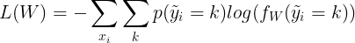
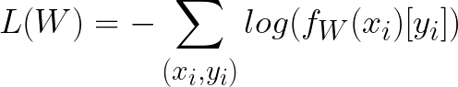
Better Solution: Cross-Entropy
Let us assume that f outputs a probability over the K output classes
We use the differentiable cross-entropy objective:
As the labels are assumed to be deterministic this simplifies as:

Slide 20
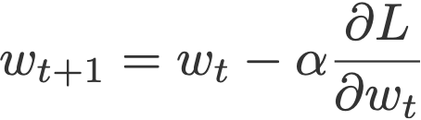
Optimization
Many methods were proposed to find the best weights W
Hard to beat Stochastic Gradient Descent (SGD) in practice
Computing this looks like O(N²), but due to backpropgation is O(N)

Slide 21
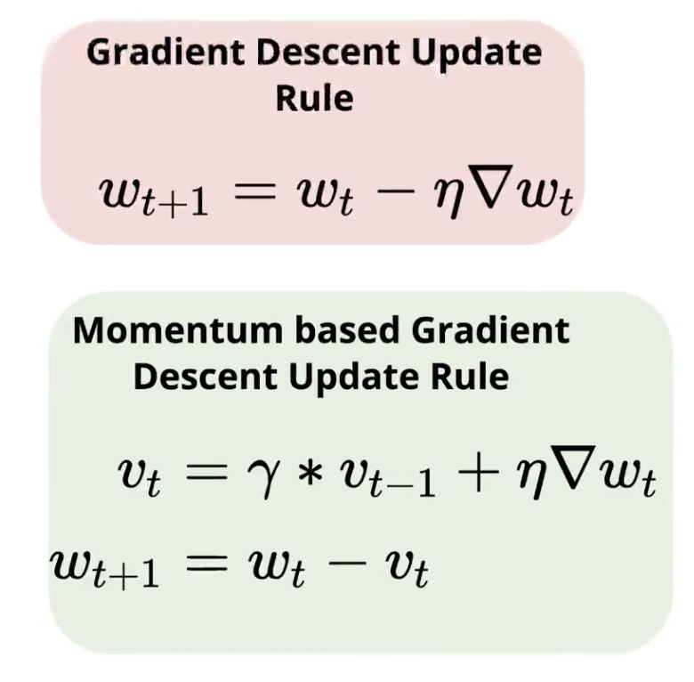
SGD with Momentum
Momentum typically used in practice
Intuition: reduces noise by biasing step in direction of previous steps
Choosing the learning rate, momemtum is very important
Many hand-crafted or automatic tricks for doing so, not our scope

Slide 22
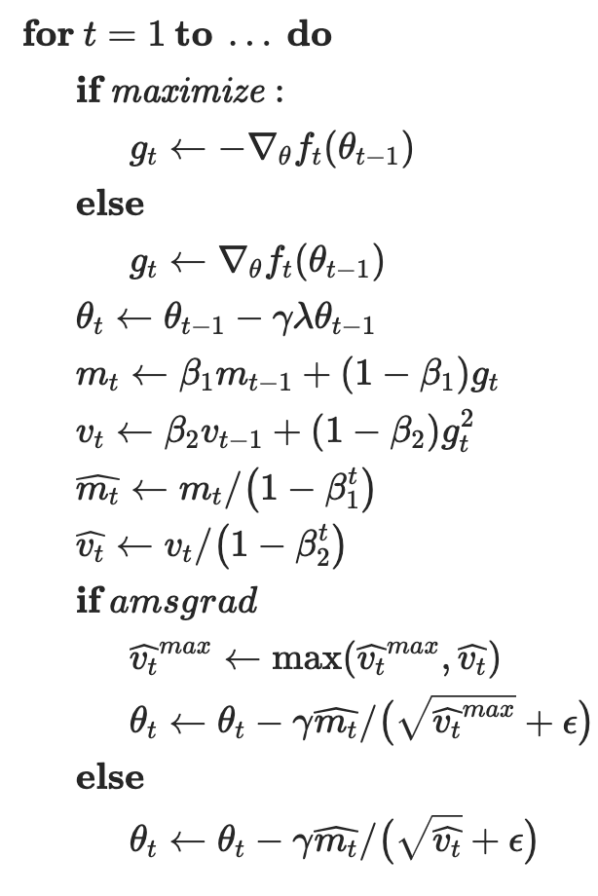
Adaptive Optimizers
SGD does not automatically adjust step size
Adaptive methods do e.g. ADAM, AdamW
Compute average gradient and square norm
Scale momentum by average gradient norm
Less sensitive to parameters than SGD-M

Slide 23
Empirical Risk Minimization (ERM)
So far, we assumed the training set was very, very large
In practice, the training set is limited
We minimize the empirical risk = error on training set
Really care about true risk = error on all images in the world
In other words, we want generalization

Slide 24
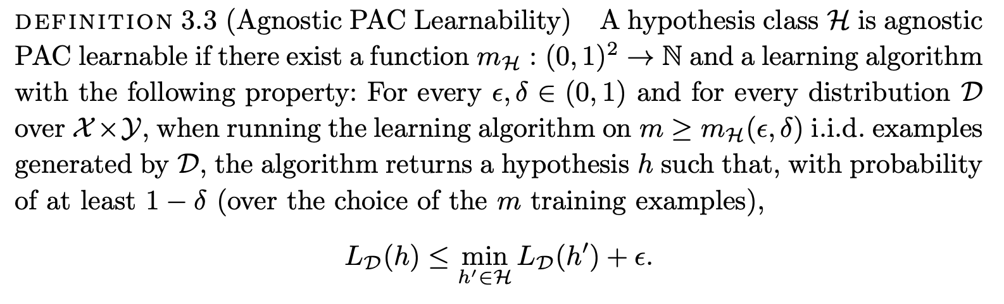
Formal Definition of PAC Learning
PAC = probably approximately correct
Definition from Shai Shalev Shwartz’s book

Slide 25
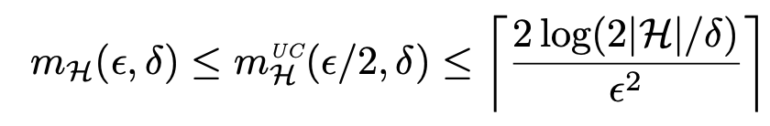
Classical Bounds on Learnability
In IML, you have learned to bound the number of examples:
Which contains the number of possible configurations of parameters
Infinite for continuous H, but can be made finite by discretization

Slide 26
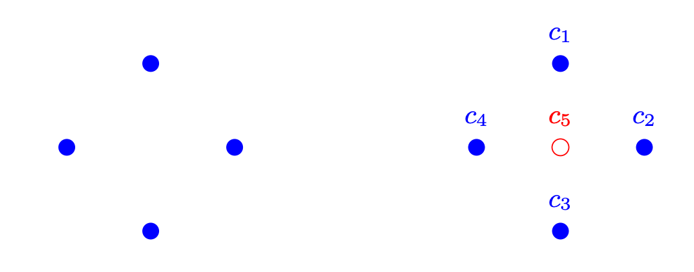
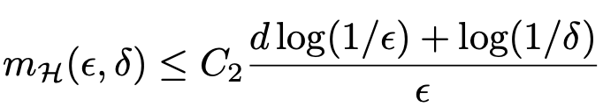
VC-Dimension
A major breakthrough by Vapnik and Chervonenkis
Learnability is measured by set size that can be “shattered” by H
Quantified by VC dimension d
Sometimes finite, even for continuous hypothesis classes
Linear classifier with n parameters -> d scales with n

Slide 27
When Theory from IML Works Well
The theory we learned in IML works when hypotheses are simple
Example: linear functions, decision trees
Really useful to know how many examples are needed for learning
A big deal for making decisions in science and industry
Budget allocation
Go/ no go etc.

Slide 28
Real World Hypothesis Class Requirements
The classifier functions must satisfy several properties
Being expressive
providing a good fit for the training data
Being amenable to optimization
need to find function parameters minimizing the objective at reasonable time
Generalization
Not requiring too many training samples for reducing the true risk

Slide 29
Linear functions are often insufficient
Linear models or simple trees are often not enough
They are good at:
Optimization - they are easy to optimize
They are ok at:
Generalization - they do not overfit much for not too many parameters
They are poor at:
Expressivity – they cannot classify complex data e.g. pixel to object category

Slide 30
Compare this to deep NNs
They are good at:
Expressivity – they can classify complex data e.g. pixel to object category
Generalization – they overfit much less than their parameter count suggests
They are ok at:
Simple optimization algorithms tends to find good local optima
They are poor at:
Optimization takes a lot of time (much compute and memory)

Slide 31
Classical ML Theory and Modern Methods
Classical ML theory does not generlize well to deep networks:
Deep NN should overfit
SGD on deep NNs should not converge
What do you think is the place of theory in modern ML?

Slide 32
Improving Generalization
In classical ML expressivity comes at the price of generalization
Improving generalization can occur by giving up expressivity
We would like to give up in areas that are not useful
Simplest method: choose a suitable hypothesis class
Are trees or linear models most suitable for my task?
Do I really need deep NNs?

Slide 33
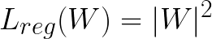
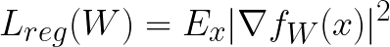
Regularization
Choose very expressive function class
Reducing unneccesary expressivity by:
Forcing weights to be small
Forcing function to be smooth

Slide 34
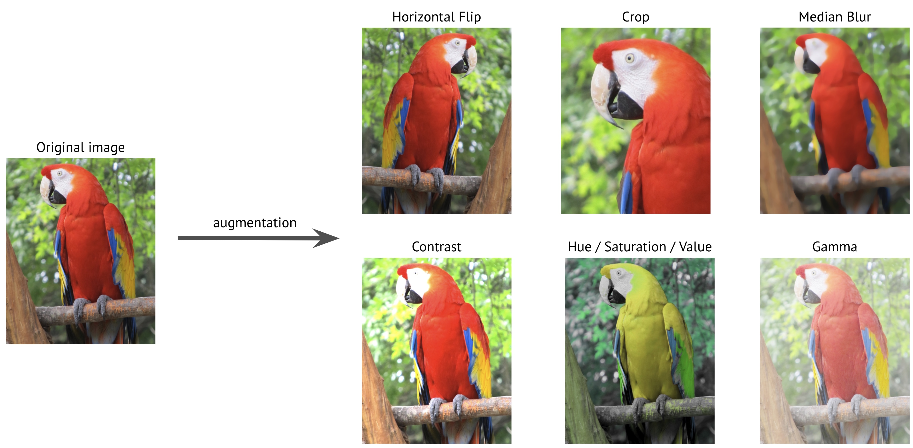
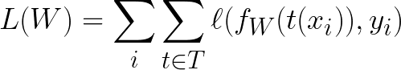
Augmentation
Synthetically increase the number of training data
Assume we know an operation T(x) which changes x but not the label
Examples for ImageNet: add noise, slight color change, cropping
New objective:

Slide 35
Supervised ML pipeline
Input: (x₁, y₁),(x₂, y₂)..(x_{n}, y_{n})
Choose a hypothesis class (linear, tree, DNN) with parameters W
Choose loss function e.g. cross entropy
Choose regularization (e.g. L2) and augmentation (e.g. add noise)
Train parameters with SGD+momentum

Slide 36
General comment
In this course, we will not put too much emphasis of the function f
In most modern systems, it is a deep neural network
In the future, it may be something else
We will devote the next week to reviewiing DNN implementation
DNNs not always the answer now, may not be popular in the future
Keep an open mind

Slide 37
Code practice
https://pytorch.org/tutorials/beginner/blitz/cifar10_tutorial.html

